Slide 1


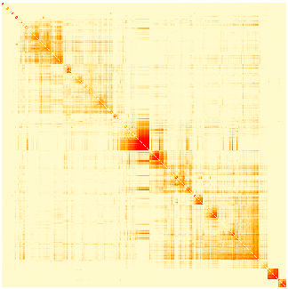
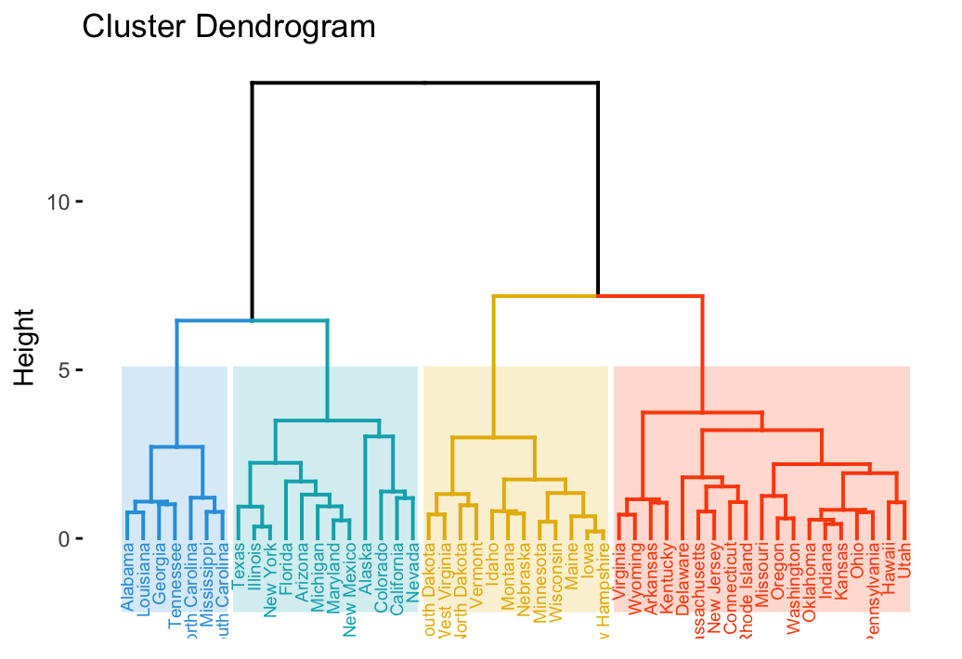
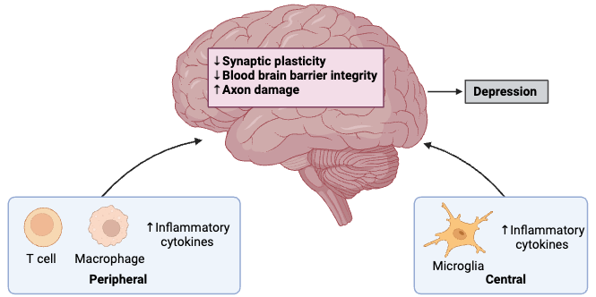
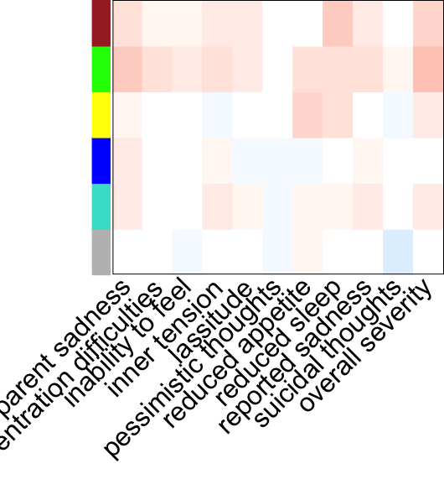




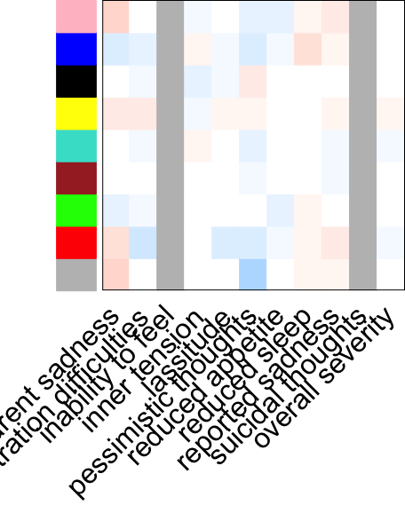

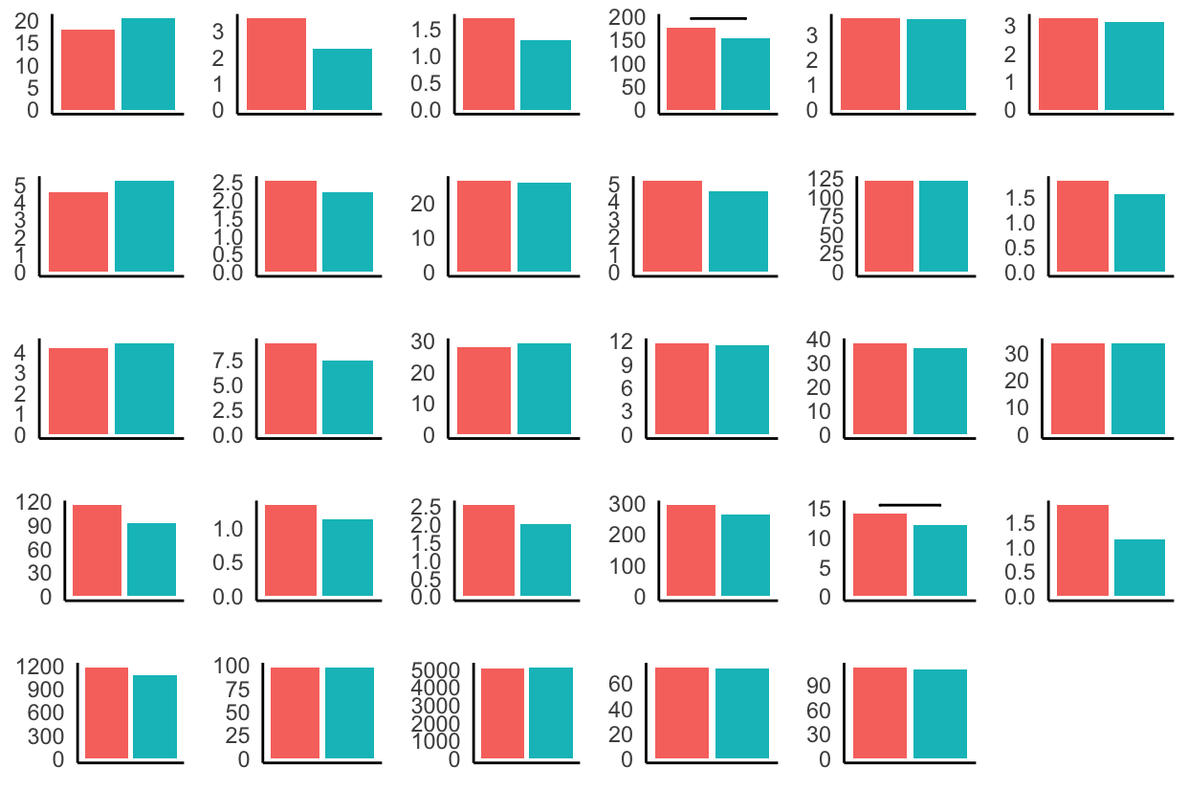


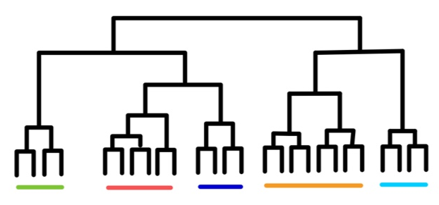
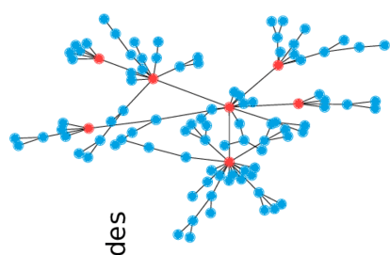






Multivariate Analysis Using Co-Expression Network Modeling Identifies Specific
Inflammation and Neurological Disease-Related Genetic Modules
in Major Depressive Disorder
Lucy Hui, Joanna Chen, Jean Chen
Rotman Research Institute, Baycrest Health Sciences, Toronto, Canada
BACKGROUND
PIPELINE
Major depressive disorder (MDD)
MDD is the most prevalent psychiatric condition marked by persistent sadness and cognitive impairments.
Only 50% of the MDD population respond to treatments derived from the monoamine hypothesis, implicating alternative pathophysiological underpinnings.
Recent research indicates that neuroinflammatory processes play a significant role in its development. Crucially, there are notable sex differences in both the presentation and underlying neuroinflammatory mechanisms.
Canadian Biomarker Integration Network in Depression (CANBIND-1)
Weighted Gene Co-expression Network Analysis (WGCNA)
Baseline
MDD (n = 211)
Control (n = 122)
Coexpression network
Identify modules
Relate to external traits
132 Female
74 Male
65 Female
38 Male
Participants
Modalities
Molecular
Clinical
Imaging
Participants
Genetic Modules
29 cytokines & chemokines
11 depression subcomponents
4 diffusion MRI parameters
Inflammatory markers
Depression components
MRI measures
RESULTS
MDD
Turquoise: IL2, IL5, IL6, IL8, IL12, G-CSF, MIP-1a, VEGF
Yellow: IL4, Eotaxin, IL7
Brown: IL9, MIP-1b, RANTES, TNFa
Blue: IL1b, IL10, IL13, GM-CSF
Green: IL17, FGF, PDGF
Grey: IFABP, CRP, IL1ra, IL15, IFN, IP10, MCP
Control
Pink: IL1b, IL13
Red: IL1ra, G-CSF, MIP-1a
Green: IL2, IL7, IL8, IL17
Blue: IL4, Eotaxin, IL10, MCP
Brown: IL5, IL12, GM-CSF, IFN
Turquoise: IL6, IL15, IP10, VEGF
Yellow: IL9, MIP-1b, RANTES, TNFa
Black: FGF, PDGF
Grey: IFABP, CRP
a)
b)
CDI
MDD
FWF
FA_T
Figure 1. Mechanisms of Neuroinflammation [1]
MD_T
Weighted Gene Co-expression Network Analysis (WGCNA)
Bioinformatics tool used to identify modules or clusters of highly correlated genes across different biological conditions.
Constructs a network where nodes represent genes and edges represent pairwise correlations between gene expression profiles.
Unveils biological processes by associating modules with phenotypic traits, clinical outcomes, or experimental conditions.
Figure 3. Inflammatory modules detected by WGCNA in MDD and control subjects.
IFBAP
CRP
IL1b
IL1ra
IL2
IL4
CDI
IL5
IL6
IL7
IL8
IL9
IL10
Control
FWF
FA_T
IL12
IL13
IL15
IL17
Eotaxin
FGF
MD_T
G-CSF
GM-CSF
IFN
IP10
MCP1
MIP1a
CDI: Correlation diffusion index
FWF: Free water fraction
FA_T: Free water corrected fractional anisotropy
MD_T: free water corrected mean diffusivity
Anhedonia
Inner tension
Lassitude
Figure 2. Hierarchical clustering for scale free networks [2-3]
Pessimism
Reduced appetite
Reduced sleep
Reported sadness
Suicidal thoughts
Apparent sadness
Overall severity
OBJECTIVES
PDGF
MIP1b
RANTES
TNFa
VEGF
IL4
Reduced focus
Identify sex-dependent modules of co-expressed genes associated with inflammatory biomarkers in MDD patients and healthy controls, elucidating shared and distinct networks underlying inflammation in depression.
Assess the correlation between inflammatory gene expression modules, clinical variables, and neuroimaging markers to elucidate the clinical relevance of immune dysregulation in MDD.
MDD
Control
Figure 4. Average inflammatory marker levels (mg/L) in MDD and control subjects. Horizontal bar depicts p<0.05.
Montgomery–Åsberg Depression Rating Scale
Diffusion MRI-based Brain Parcellation
Figure 5. Module-Trait correlations for depression (a) and MRI (b). Red: r²>0. White: r²=0. Blue: r²<0. Grey: missing values.
DISCUSSION
ACKNOWLEDGEMENTS
REFERENCES
WGCNA-derived brown and green inflammatory modules revealed positive correlations with the traits of depression, fractional anisotropy, and mean diffusivity in MDD.
A negative correlation of inflammatory modules in MDD with correlation diffusion index in white matter tracts implies decreased white matter integrity.
Future results will subset the effects of microglial-specific inflammatory markers in the central nervous system.
This project is supported by the Data Sciences Institute, University of Toronto
Miller, A., Raison, C. The role of inflammation in depression: from evolutionary imperative to modern treatment target. Nat Rev Immunol 16, 22–34 (2016). https://doi.org/10.1038/nri.2015.5
Kim, C. How to find the optimal number of clusters with R? Medium (2022). https://medium.com/@chyun55555/how-to-find-the-optimal-number-of-clusters-with-r-dbf84988388b
Wurzburg, J. Synchrony Measurement and Connectivity Estimation of Parallel Spike Trains from in vitro Neuronal Networks (2020). DOI:10.25972/OPUS-22364.
lucy-mhui

